Slide 1





Movie Recommendation System

Slide 2


Recommendation System has two types :
VS
1- Content-Based Filtering
E.g. Netflix It recommends items based on a comparison between the content of the items and a user profile.
Action-Drama-Comedy
2- Collaborative Filtering
E.g. Amazon It recommends items by collecting preferences or taste information from many users.
Laptop- Laptop bag
Mobile Phone- Mobile Phone Accessories

Slide 3









In the first part of project, we will focus on providing a recommendation system, it tells the user what movies/items are most similar to his movie choice.

Slide 4

Let's get started!

Slide 5
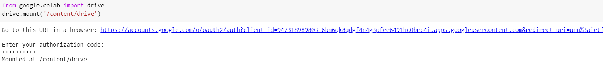
- Connect to google drive

Slide 6
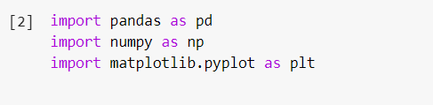
- Import libraries

Slide 7
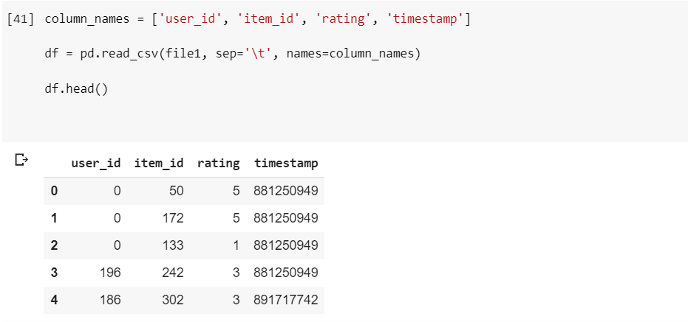
- Get the data

Slide 8
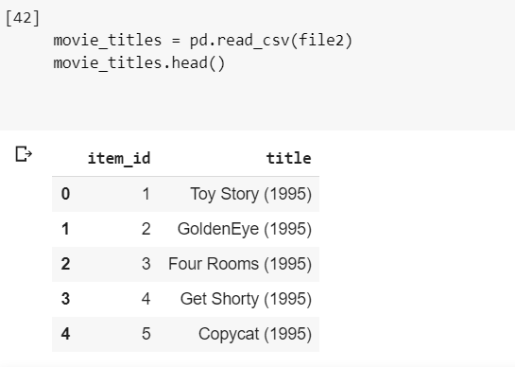
- Get the movie titles

Slide 9
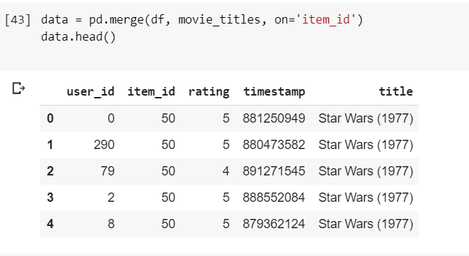
- Merge them together

Slide 10
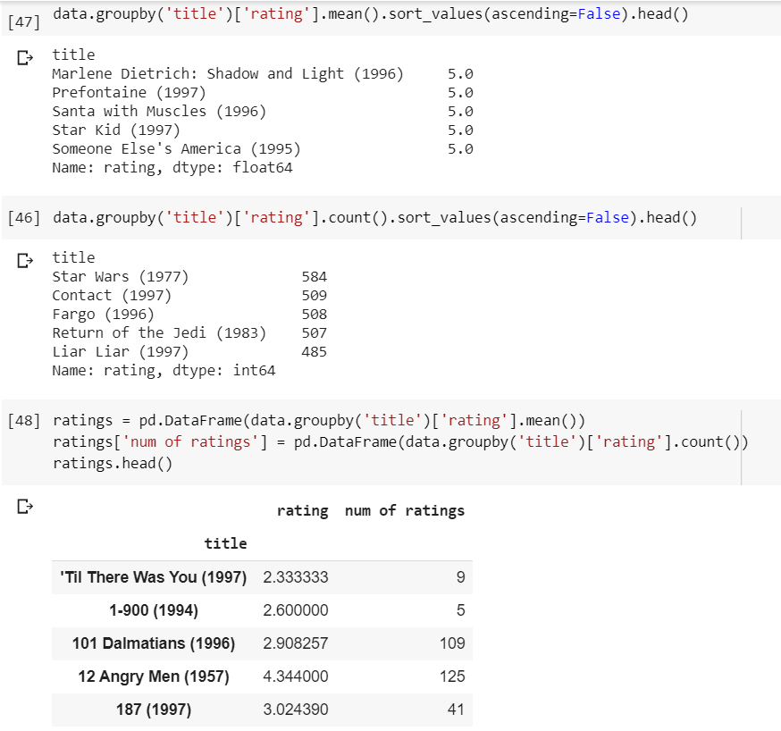
- Create a ratings dataframe with average rating and number of ratings

Slide 11
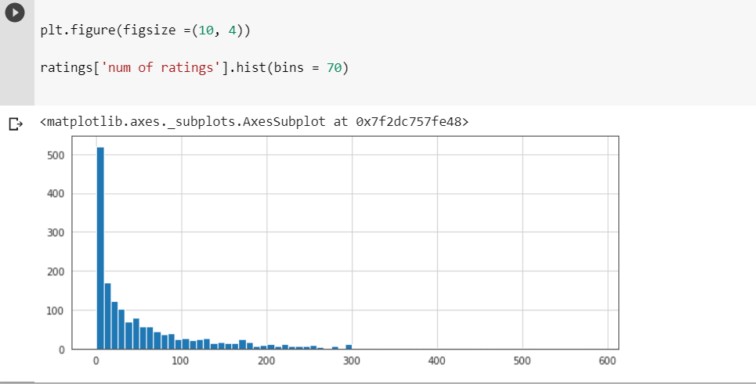
- Histogram of num of ratings

Slide 12
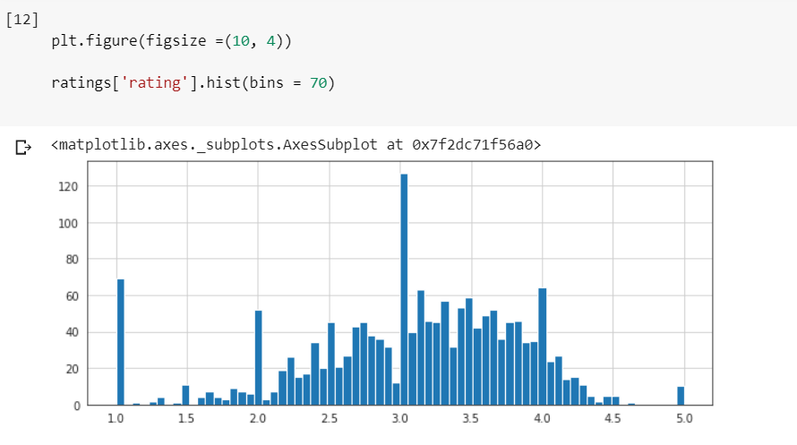
- Histogram of ratings

Slide 13
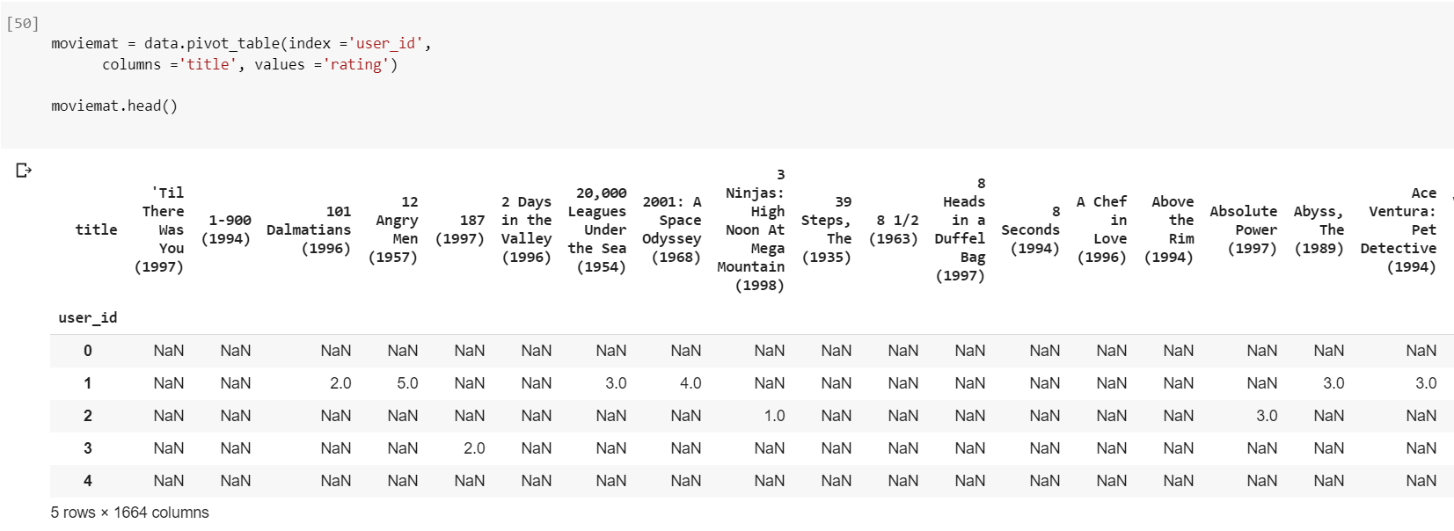
Create a matrix that has the user ids on one access and the movie title on another axis. Each cell will then consist of the rating the user gave to that movie
NaN means have not seen the movie.

Slide 14
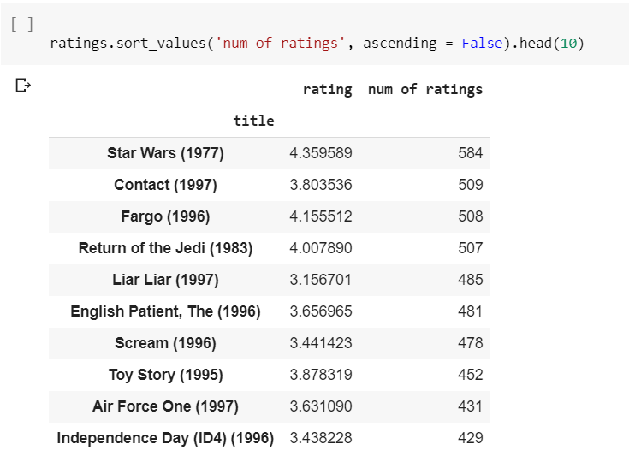
- Most rated
movies

Slide 15
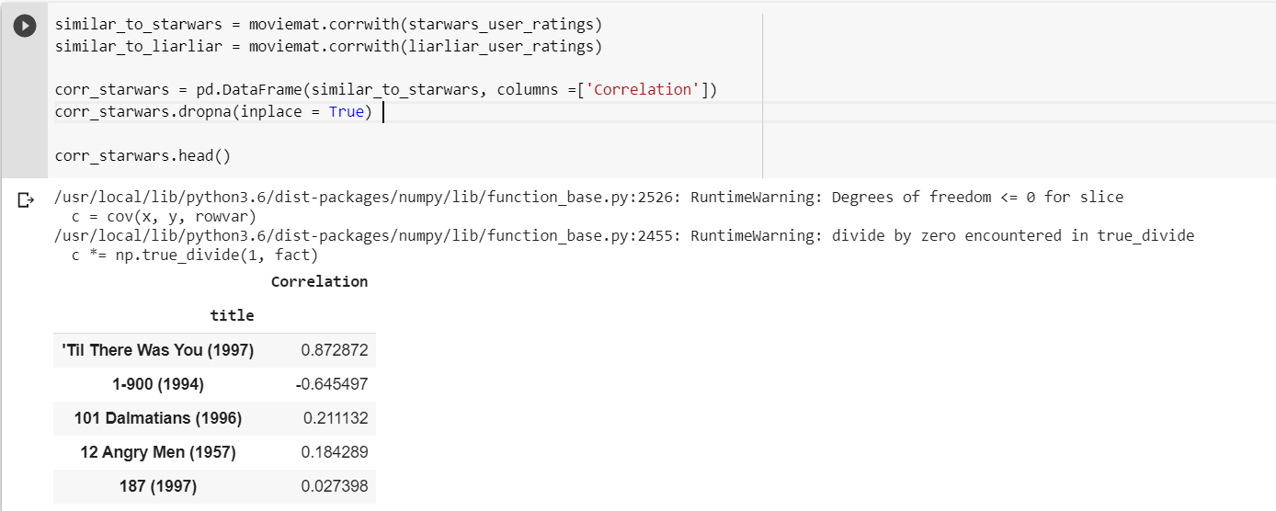
- Use corrwith() method to get correlations between two pandas series & clean this by removing NaN values and using a DataFrame instead of a series

Slide 16
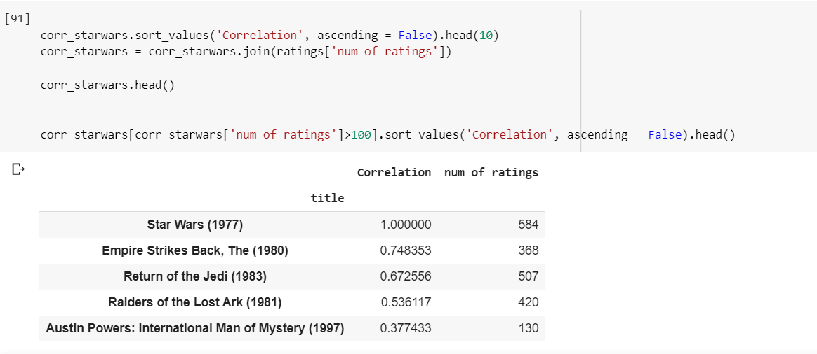
- Sort the dataframe by correlation
- Filtering out movies that have less than 100 reviews

Slide 17
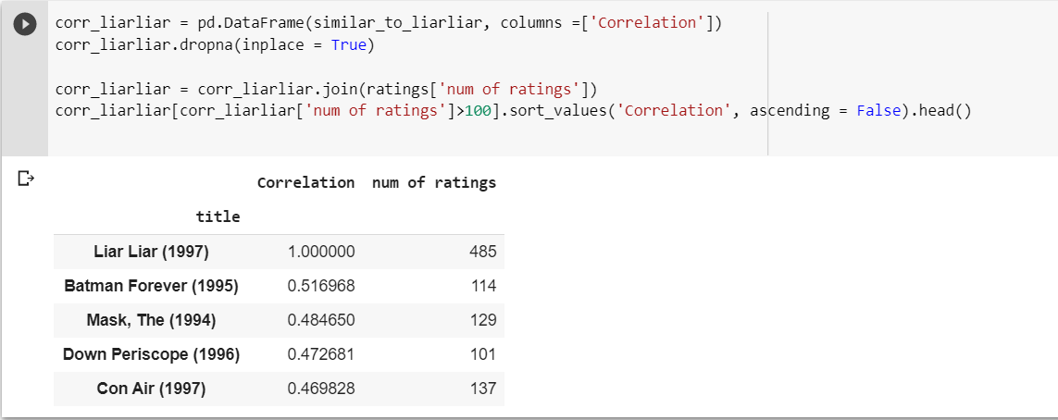
- Now the same for the comedy Liar Liar

Slide 18
In the second part of project, we will focus on providing a recommendation system, it tells the user what movies/items are most similar to his movie genre.

Slide 19

Let's proceed!

Slide 20
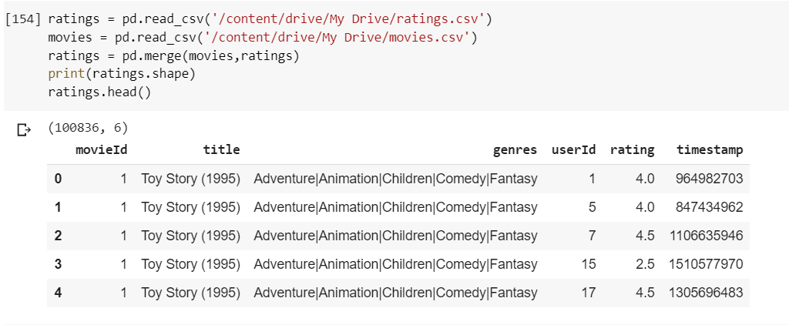
- Get the data

Slide 21
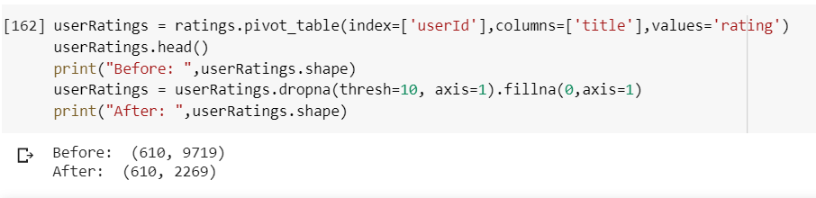
Create a matrix that has the user ids on one access and the movie title on another axis. Each cell will then consist of the rating the user gave to that movie
We remove all the movies that has less than 10 users who have rated it

Slide 22
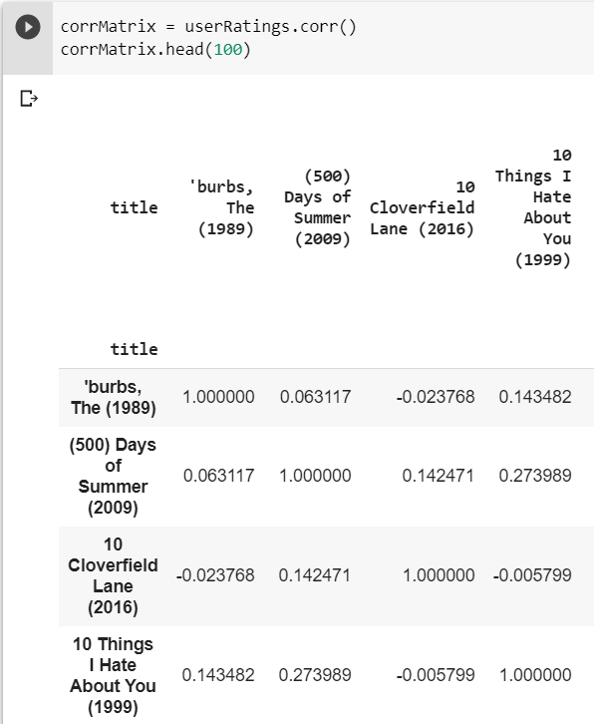
- Get the correlation

Slide 23
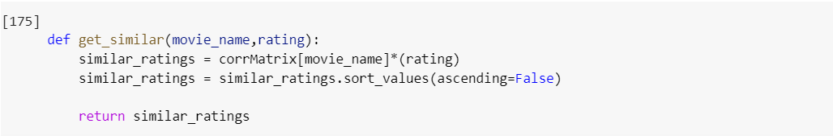
Function to get similar movies

Slide 24
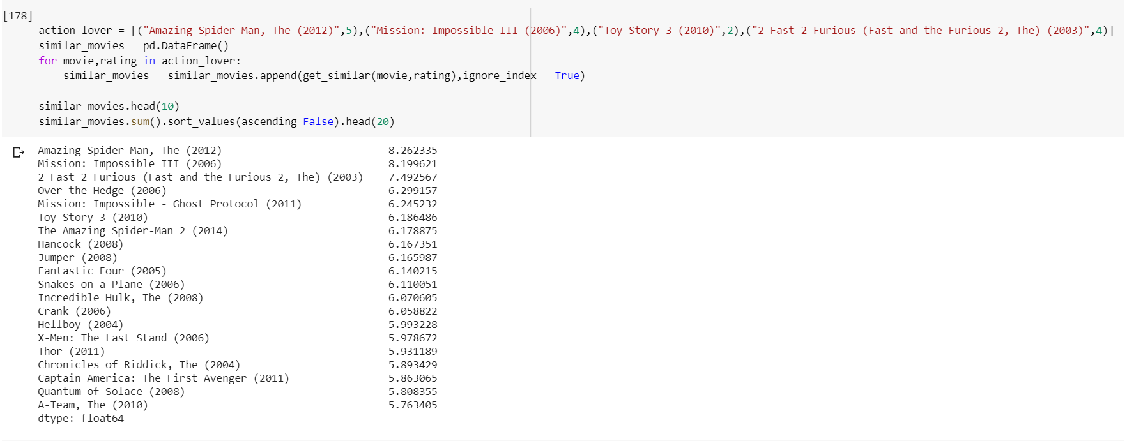
Output for action lovers

Slide 25


Follow us on Github: https://github.com/yshimaa66/Movie _Recommender_System_using_Python

Slide 26





References:

Slide 27
Credits
Special thanks to :
DR. Mustafa Elattar
Eng. Passant Amin

Slide 28
Thanks!
Shimaa Yasser
Abdelrahman Basry
Mohamed Mohamed Sabry

